Slide 1
Facilities Health Services IA Study, Round 2
Prepared by the VA.gov CMS Team
Prepared for and presented to the Team 1
May 2019

Slide 2
HIGH-LEVEL SUMMARY
The VA.gov CMS team conducted 17 in-person usability tests with Veterans and a tree test (n=255) to understand if people could find and comprehend the health and facility services they have access to. Our goal was to evaluate the pros and cons of having health/facility services content presented in (1) alphabetical order or (2) grouping by similarity (primary care, specialty care, etc.). An ancillary goal was to identify any new patterns that could further improve the UX. We found that while both content structures presented critical usability problems for people, a grouped structure seemed more useful in creating a memorable wayfinding experience. Additionally, we observed that miscellaneous categories caused more confusion than benefit for users.

Slide 3
Outline
This research focused on the information architecture, content, and design patterns used on the Facility Invision prototype.
1. Study Goals
2. Research Methods
3. Findings: Prototype testing
4. Findings: Tree testing
5. Recommendations
6. Next steps

Slide 4
1. Study Goals

Slide 5
Gain a qualitative understanding of the effectiveness of the proposed design.
STUDY GOALS: PROTOTYPE TESTING
Evaluate the pros and cons of having health/facility services content presented in:
alphabetical order (A-Z grouping)
grouping by similarity (primary care, specialty care, etc.)
Identify design patterns or content adjustments that could improve the experience for Veterans
Notes:
if participants can find and understand the health services they need.

Slide 6
Quantitatively evaluate the effectiveness of a proposed architecture for grouping services.
STUDY GOALS: TREE TESTING
Determine how accurately participants complete health-service-focused and “other”-service-focused tasks.
Identify design patterns or content adjustments that could improve their experience
Notes:
To test if participants can find and understand the health (and other) services they need, within a grouped structure.

Slide 7
2. Research Methods

Slide 8
Mixed methods approach to deepen understanding
RESEARCH METHODS
Prototype testing (i.e. “usability” testing)
Qualitative methodology
Small sample, moderated
Helps us understand sentiments and concerns in the Veteran’s voice and context
Tree testing
Quantitative outputs
Large sample, un-moderated
Indicates potential opportunities and problem areas, non-contextual
Notes:
Most participants were visiting for appointments. At the Seattle VAMC, participants were both waiting for appointments and attending a health fair.
Sessions lasted anywhere from 5 to 30 minutes, depending on participants’ availability. Most sessions lasted longer than 10 minutes.
Lessons learned: Open lobby/hallway spaces are too distracting for these kinds of interactions. Additionally, simultaneous events (e.g., health fair) provided extra distraction.

Slide 9
We visited 2 facilities and intercepted 17 Veterans.
RESEARCH METHOD: PROTOTYPE TESTING
Sessions lasted from 5 to 30 minutes, per participant’s availability.
Most sessions lasted longer than 10 minutes.
Used two clickable prototypes in Invision (a design tool).
alphabetical order (A-Z grouping)
grouping by similarity (primary care, specialty care, etc.)
Lessons learned: Open lobby/hallway spaces are too distracting for these kinds of interactions. Additionally, popular events (e.g., health fair) provide additional distraction.
Notes:
Most participants were visiting for appointments. At the Seattle VAMC, participants were both waiting for appointments and attending a health fair.
Sessions lasted anywhere from 5 to 30 minutes, depending on participants’ availability. Most sessions lasted longer than 10 minutes.
Lessons learned: Open lobby/hallway spaces are too distracting for these kinds of interactions. Additionally, simultaneous events (e.g., health fair) provided extra distraction.

Slide 10
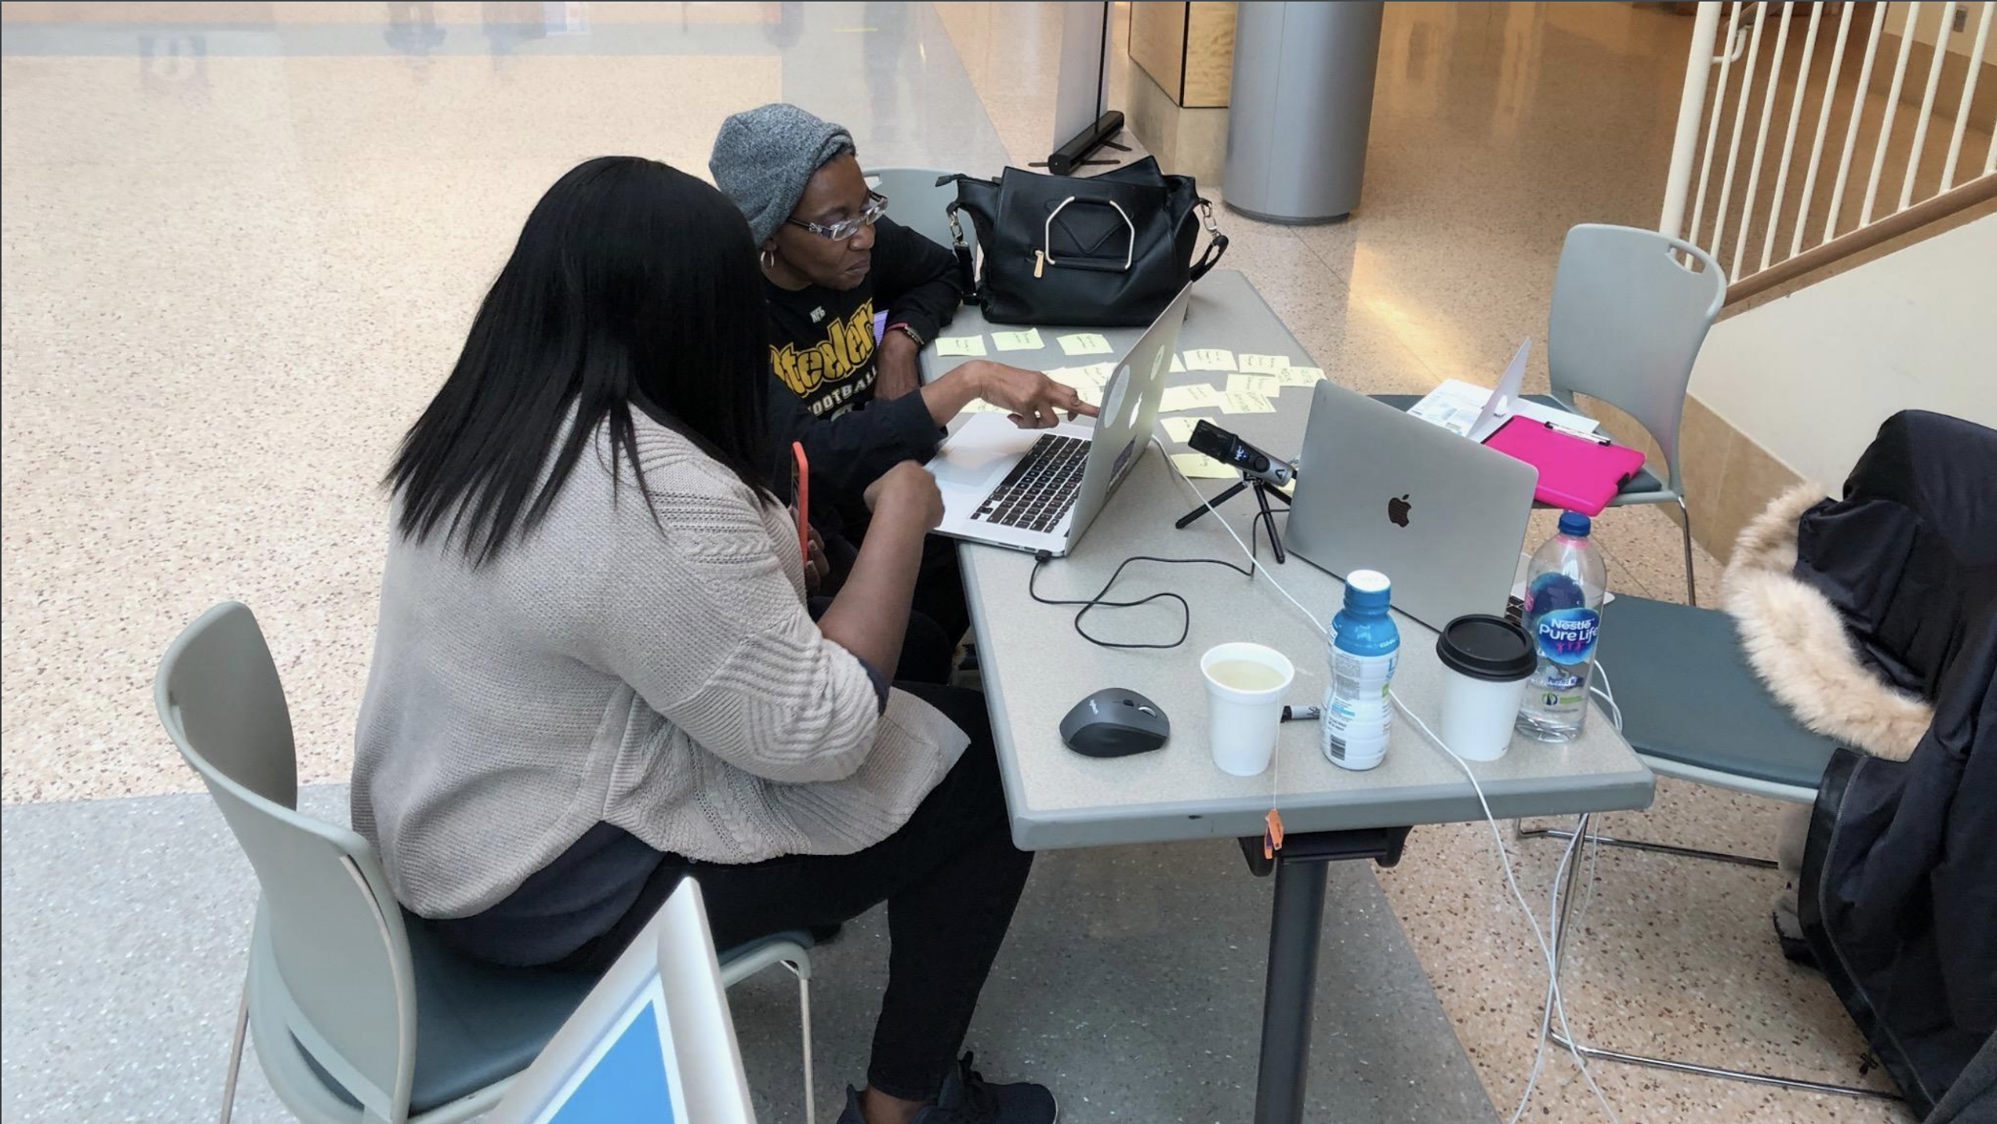
We tested at a VA to gain a complete understanding.
RESEARCH METHOD: PROTOTYPE TESTING
A former team member evaluating designs with a Veteran
Notes:
The treejack test investigated the effectiveness of grouped content (including the accordion content).

Slide 11
Tasks and scenarios focused on answering:
RESEARCH METHOD: PROTOTYPE TESTING
Are participants able to navigate to Locations and services > A-Z services?
Are participants able to find the service they need within A-Z services?
What questions or blockers do they face when trying to find the target service?
What are participants’ reactions to the medical terms within the services list?
Are they able to understand the terms?
Do they suggest alternative terminology?
What are participants’ reactions to viewing services in an A-Z list and grouped?
Notes:
What other suggestions (re: navigability, plain language, etc.) do participants offer?

Slide 12
We created a tree test in Optimal Workshop.
RESEARCH METHOD: TREE TESTING
A menu-like activity that evaluates participants’ comprehension of content captured under Our Health Services
Included 16 tasks, 10 tasks randomly shown to each participant
A total of 473 people participated in the test.
54% of participants (255) completed the full test.
Median completion time = 8:05.
Deployed over a 2 week window

Slide 13
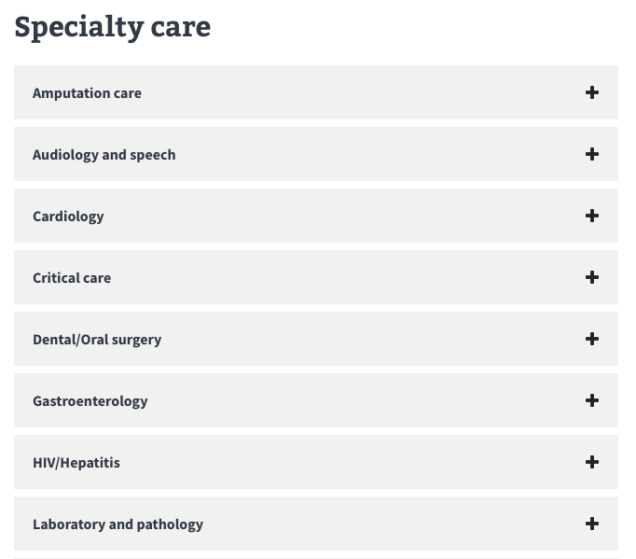
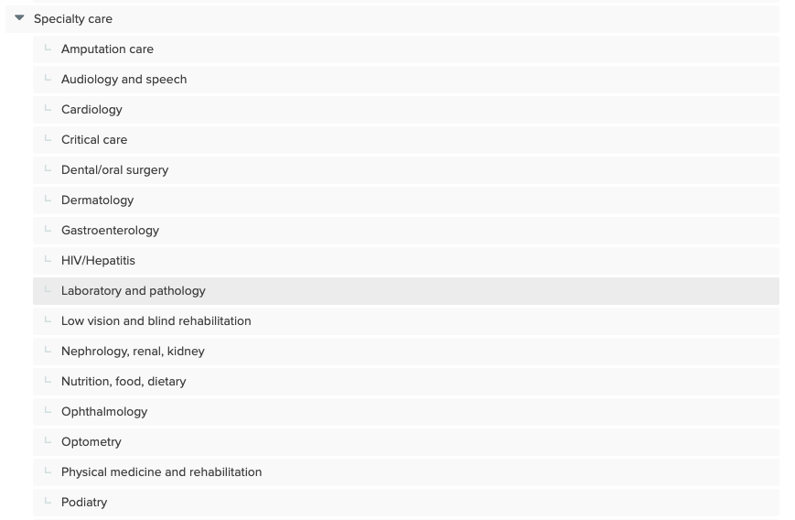
The tree test abstracted navigation and accordion content to test the effectiveness of group labels.
RESEARCH METHOD: TREE TESTING
UI appearance
TreeJack appearance
Notes:
The treejack test investigated the effectiveness of grouped content (including the accordion content).
We structured the tree as we did because, in order to access the specific service(s) they need, users will have to click into an accordion (much as they had to click through different levels of the tree).
Although the solution wasn’t perfect, we hoped it would replicate the experience of clicking into the accordions to learn more about various services.

Slide 14
3. Findings: Prototype testing

Slide 15
Grouping seemed helpful to most, but critically troublesome to others.
FINDINGS: PROTOTYPE TESTING
Both list architectures presented usability problems with wayfinding, due to a perceived lack of plain language on the accordion labels.
“I prefer the grouped version here because it makes sense to me to look for things under primary care or specialty care.”
“Good idea for [label] duplication - more likely to remember it and find it.” (re: grouped services list)
“I don’t like being in a maze.” (re: grouped services list)

Slide 16
Where’s my search bar?
FINDINGS: PROTOTYPE TESTING
People could not find the search bar in the prototype. Some expected a search function that helps them connect their own understanding of their problem and medical terminology.
“Is there a search button? I would have gone straight to that, but I don’t see it.”
“Would have searched for ‘Foot care.’”
“‘Speciality Care’ doesn’t really tell me what the specialty care list is. Should be a description or summary.”
“Search should be on the left menu, too.”

Slide 17
Product trust > VA authority
FINDINGS: PROTOTYPE TESTING
My HealtheVet is a recognized and trusted product. Acknowledging the relationship between the old and new can help bridge trust gaps.
“I would have rather seen ‘My HealtheVet’ at the top. That would have made more sense.”
“If I’m just refilling my prescription, I’d go to My HealtheVet.”

Slide 18
Digital tools don’t replace human validation
FINDINGS: PROTOTYPE TESTING
Even with digital options, participants expressed either the need or the preference for a human touchpoint — in this case, a phone call.
“Were I someone who is not familiar, I don’t know what I would do. Probably call the general phone number (866-...).”
“I would call the hotline and refill my prescription.”
“Usually call to make my appointment, normally make it online and then call to verify.”

Slide 19
4. Findings: Tree testing

Slide 20
The findings from our tree testing mirrored those of our hallway testing.

Slide 21
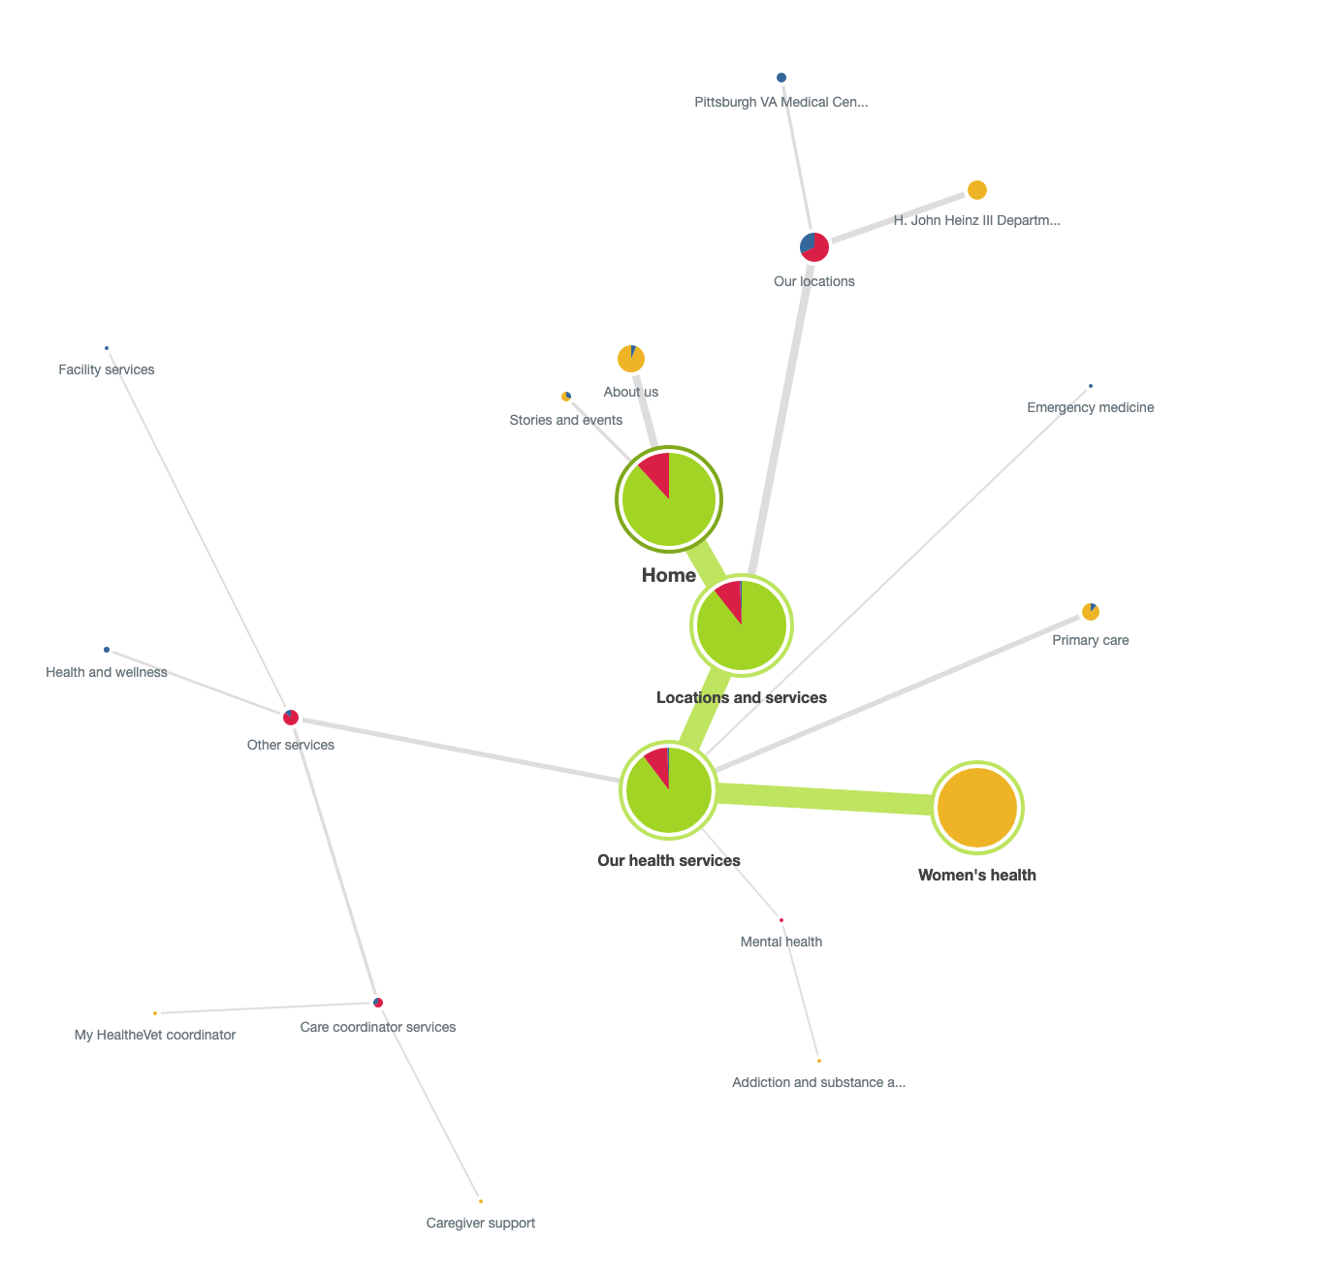
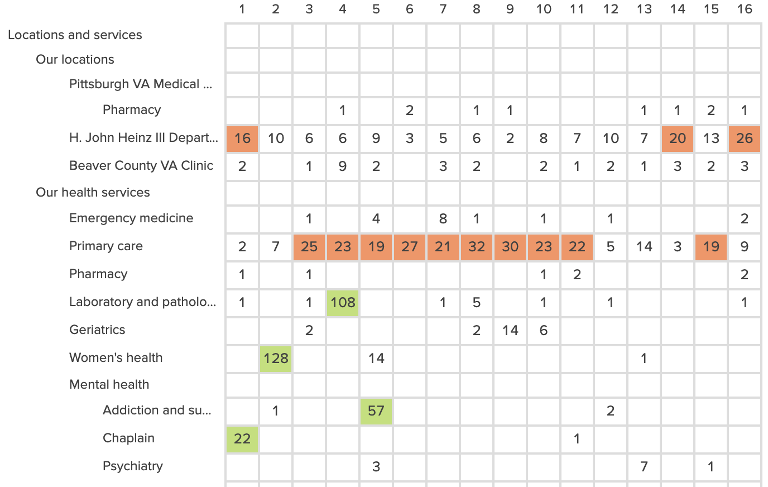
Examples tree test results and how to interpret them.
RESEARCH METHOD: TREE TESTING
Pie trees. (this one is relatively successful)
Destination matrix. (selection by task)
Larger green line, sparser tree = better
High number in green = better
Notes:
The treejack test investigated the effectiveness of grouped content (including the accordion content).
We structured the tree as we did because, in order to access the specific service(s) they need, users will have to click into an accordion (much as they had to click through different levels of the tree).
Although the solution wasn’t perfect, we hoped it would replicate the experience of clicking into the accordions to learn more about various services.

Slide 22
The “Health Services” grouping was useful to participants, but “Other Services” was not.
FINDINGS: TREE TESTING
The tasks with the lowest success rates were those that asked participants to find services grouped within “Other Services.”
Task 6 (vision limitations): 27% success
Task 15 (returning service member who needs information about transitioning into civilian life): 27% success
Task 12 (employment rehabilitation programs): 31% success
Tasks 11, 9, and 16: 32% success (tied)
Task 10 (caregiver resources): 34% success
Notes:
Need to talk to someone about MyHealtheVet (32%) // Mobility services (wheelchairs) (32%) // Lodging for your family (32%) - tasks 11, 9, and 16, respectively

Slide 23
Services that are (ostensibly) more commonly used had higher task success rates.
FINDINGS: TREE TESTING
The tasks with the highest success rates focused on relatively straightforwardly described health conditions; none of the services were grouped under “Other Services.”
Task 2 (find a women’s health provider): 77% success
Task 4 (routine blood work): 66% success
Task 7 (wisdom-tooth removal): 63% success
Task 3 (consult with a nutritionist): 60% success
Task 8 (kidney conditions): 52% success

Slide 24
“Other Services,” as a descriptor, felt unclear.
FINDINGS: TREE TESTING
If someone is new to VA Health Care, they may not be aware of the non-health-related services VA offers; because of this, they might not think to explore this category of services, or they may default to exploring the more familiar Primary care (or About us).
This descriptor also doesn’t match the granularity and specificity of other categories — in short, the nebulousness of the label is not helping Veterans find the services they need.

Slide 25
Participants incorrectly nominated “About Us” and “Primary Care” as the answers for many tasks.
FINDINGS: TREE TESTING
About us was a very common failed destination (10 of 16 questions), with the highest failed destination rates.
Primary care was another common failed destinations (10 of 16 questions). This may relate to Veterans’ onsite experience of needing referrals from primary-care providers.
We need to further investigate why About Us was so commonly (incorrectly) chosen as a destination (more on this later).
Notes:
Primary care may have been incorrectly chosen because of Veterans’ experience of having to see their primary-care provider in order to get access to specialty care (which is something we heard during our onsite research).

Slide 26
Participants incorrectly nominated “About us” as the answer for many tasks.
FINDINGS: TREE TESTING
About us was another common failed destination (10 of 16 questions), with the highest failed destination rates.
For 6 tasks, the failed destination rate was more than 20%; for the remaining 4 tasks, it was between 10 and 20%.

Slide 27
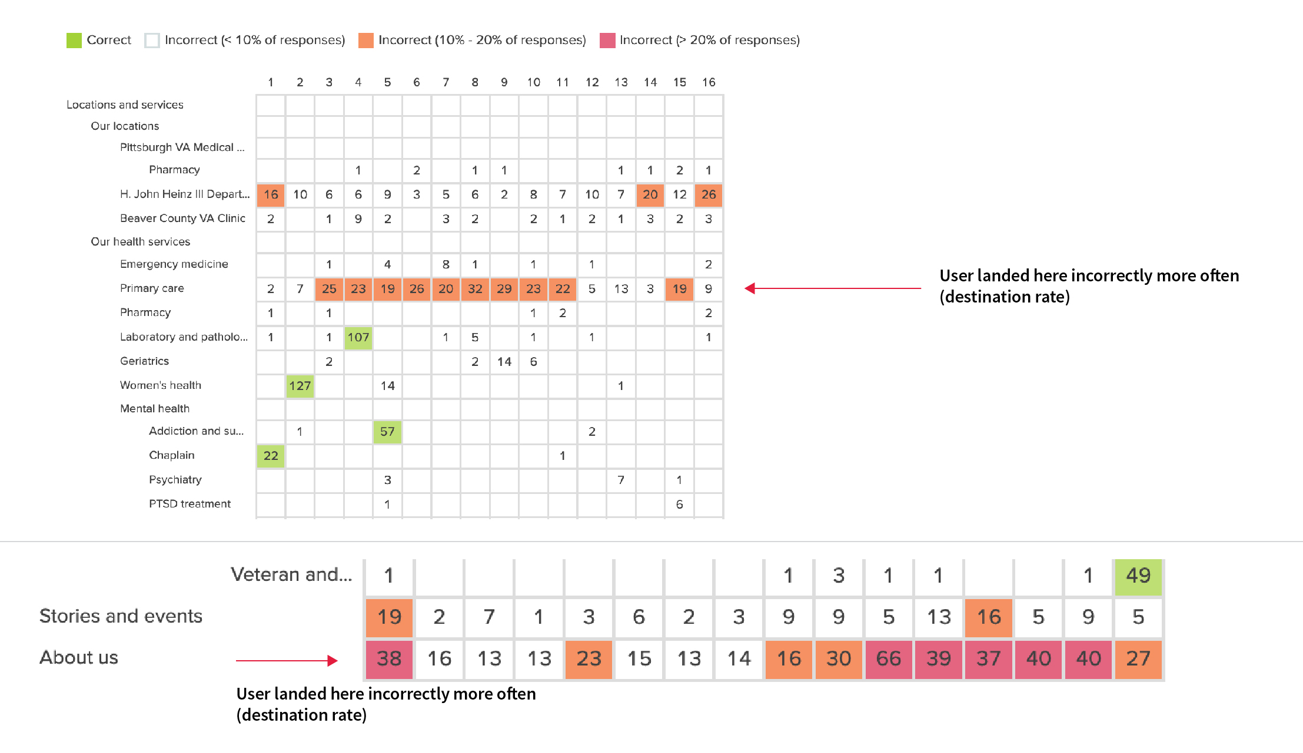
FINDINGS: TREE TESTING
Notes:
Here’s a visual representation of the destination fail rates. The row of orange boxes represents fail rates for Primary Care, and the row of red and orange boxes represents fail rates for About Us.

Slide 28
5. Recommendations

Slide 29
Our recommendations from both types of testing fall into five broad categories:
Content
Information architecture
Filter/sort/search improvements
Visual design
Additional research

Slide 30
Because our findings from the tree test built on the findings from our prototype tests, we’ve created a list of recommendations that draws on both bodies of research.

Slide 31
Recommendation (1 of 7)
RECOMMENDATIONS: INFORMATION ARCHITECTURE (TREE TESTING)
Avoid miscellaneous groupings like “Other Services.”
As a user, I want common-language group labels with some degree of specificity, so that I can tell if these services are generally what I need.
As a user, I want smaller groupings so that I can hone in on the exact service I am looking for.
As of May 29, the team has proposed an architecture that avoids this label.
Notes:
Making this change may eliminate the confusion stemming from “Other Services.” It draws on the finding that “Services that are (ostensibly) more commonly used had higher task success rates.”

Slide 32
Other services: proposed IA
RECOMMENDATIONS: INFORMATION ARCHITECTURE (TREE TESTING)
Mental health
Specialty care
Care coordinator services
Caregiver support
(etc.)
Service advocacy programs
Chaplain
(etc.)
Health and Wellness
(And so on)
Previously, these were nested under “Other services”
Notes:
Making this change may eliminate the confusion stemming from “Other Services.” It draws on the finding that “Services that are (ostensibly) more commonly used had higher task success rates.”

Slide 33
Recommendation (2 of 7)
RECOMMENDATIONS: INFORMATION ARCHITECTURE (TREE TESTING)
Redundancies hold low value, so provide only one path per service.
Keep Chaplain under Mental Health (remove from Other Services)
Keep Laboratory and Pathology under Our Health Services (remove from Specialty Services)
Keep Nutrition, Food, and Dietary under Specialty Care (remove from Other Services)
As a user, I want each service to be under one possible header, so that I am able to more confidently find that service again.
As of May 29, labels no longer repeat between categories. The only edge case is including a redundancy in a proposed Featured Services section.

Slide 34
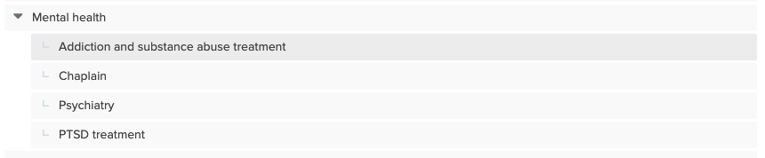
Chaplain
RECOMMENDATIONS: INFORMATION ARCHITECTURE (TREE TESTING)
Keep this path

Slide 35
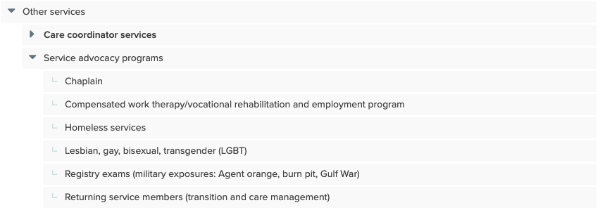
Chaplain
RECOMMENDATIONS: INFORMATION ARCHITECTURE (TREE TESTING)
Remove this path

Slide 36
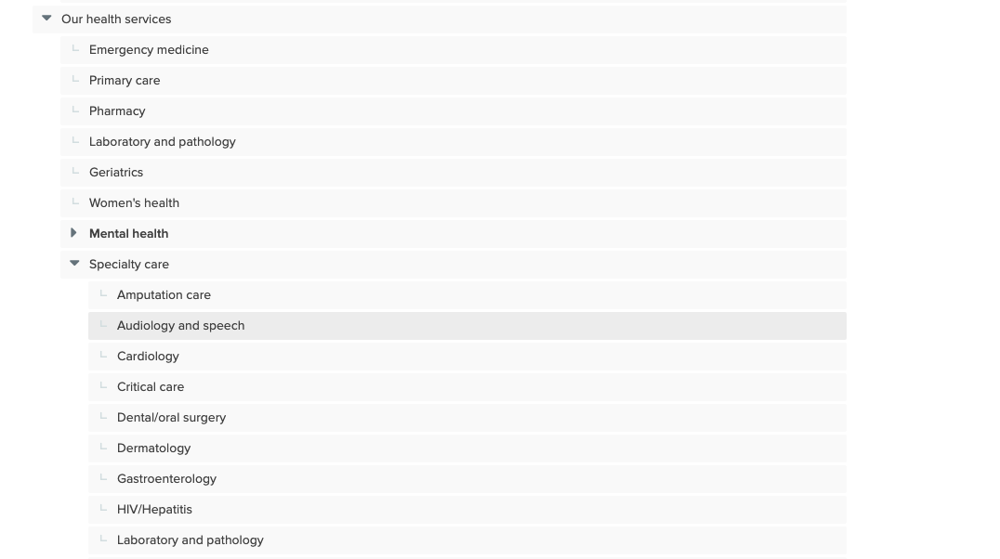
Laboratory and pathology
RECOMMENDATIONS: INFORMATION ARCHITECTURE (TREE TESTING)
Keep this path
Remove this path

Slide 37
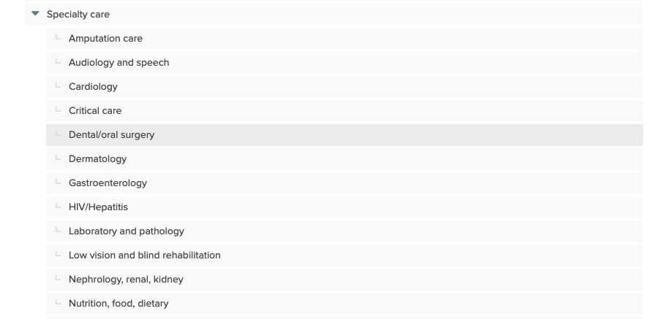
Nutrition, Food, and Dietary
RECOMMENDATIONS: INFORMATION ARCHITECTURE (TREE TESTING)
Keep this path

Slide 38
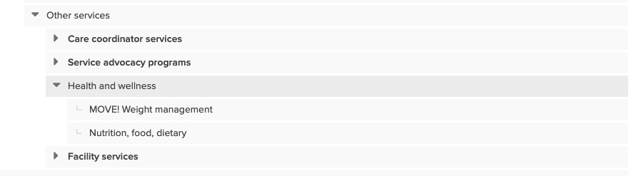
Nutrition, Food, and Dietary
RECOMMENDATIONS: INFORMATION ARCHITECTURE (TREE TESTING)
MOVE! could be moved to Specialty Services
Remove this path

Slide 39
Recommendation (3 of 7)
RECOMMENDATIONS: INFORMATION ARCHITECTURE (TREE TESTING)
Keep “Low vision and blind rehabilitation,” “Ophthalmology,” and “Optometry“ under Specialty care, and include parenthetical patient-friendly labels.
As a user, I want to see services that relate to similar kinds of conditions within proximity of each other, so that I can more accurately discern the care between the services.
As of May 29, this recommendation transcends eye care and is currently being applied across Specialty Care areas.

Slide 40
Eye Care Services: IA
RECOMMENDATIONS: INFORMATION ARCHITECTURE (TREE TESTING)
Specialty care
(...)
Ophthalmology (Eye care, ocular surgery)
Optometry (Vision specialists)
Low vision and blind rehabilitation (Accessibility, blindness)
Gastroenterology
HIV/Hepatitis
(etc.)
Notes:
Making this change may eliminate the confusion stemming from “Other Services.” It draws on the finding that “Services that are (ostensibly) more commonly used had higher task success rates.”

Slide 41
Recommendation (4 of 7)
RECOMMENDATIONS: INFORMATION ARCHITECTURE (TREE TESTING)
Reconsider what’s currently nested beneath About Us. “Jobs/Careers,” “Contact Us,” and “Policies” could be pulled out from “About Us,” making them easier for Veterans to access.
As a user, I want easy access to VA employment opportunities, policies, and contact information, so that I can connect more deeply with VA in a way that extends beyond healthcare services. Moreover, I want to access these materials without being distracted by content intended for internal users.
Further research: understand what people expect out of the About Us pages.
Notes:
Making this change may eliminate the confusion stemming from “Other Services.” It draws on the finding that “Services that are (ostensibly) more commonly used had higher task success rates.”

Slide 42
About Us: IA
RECOMMENDATIONS: INFORMATION ARCHITECTURE (TREE TESTING)
About Us
Mission and Vision
History
Leadership
Volunteer or Donate
Health and Medical Research
Jobs and Careers
Policies
Contact Us
Notes:
Making this change may eliminate the confusion stemming from “Other Services.” It draws on the finding that “Services that are (ostensibly) more commonly used had higher task success rates.”

Slide 43
Recommendation (5 of 7)
RECOMMENDATIONS: CONTENT
Revisit the navigation labels for the non-health (other) services that demonstrated low success destination rates. Such as:
Care coordinator services
Service advocacy programs
Compensated work therapy/vocational rehabilitation and employment programs
As a user, I want to see descriptive, easy-to-understand navigation titles so I can find what I’m looking for on the first try.
As of May 29, this recommendation has been adopted.
Notes:
Making this change may eliminate the confusion stemming from “Other Services.” It draws on the finding that “Services that are (ostensibly) more commonly used had higher task success rates.”

Slide 44
Recommendation (5 of 7)
RECOMMENDATIONS: CONTENT
Current label | Proposed label
Care coordinator services | Caregiver and care coordinator services
Compensated work therapy/vocational rehabilitation and employment programs | Job programs (or Employment programs)
Notes:
Notes:
“Caregiver” is a term that’s more public friendly (even if someone has no experience with VA’s medical services, they’re likely to understand what a caregiver is)
Likewise, “Job programs” and “Employment programs” are much easier to understand/much more straightforward than the current label.

Slide 45
Recommendation (6 of 7)
RECOMMENDATIONS: FILTER/SORT/SEARCH (PROTOTYPE TESTING)
Guide people to services, in lieu of a facility-specific search bar.
As a user, I want a list of the 10-12 most common conditions in plain language at the top of the page that link to the service content further down the page, so that I can feel comfortable digging into the service accordions.
Further research: what filters would work across groupings?
As a user, I would like to be able to view Health Services in a number of ways, so that I can seek what I am looking for in a way that works for me.
Notes:
In addition to adding filtered lists, we could provide a comprehensive sitemap (similar to USAA’s) to help users find the services they need.

Slide 46
Recommendation (7 of 7)
RECOMMENDATIONS: VISUAL DESIGN (PROTOTYPE TESTING)
Help people trust the new experience by giving them traces of the past. Introduce co-branding/icons to show where actions may have taken place in previous VA products.
As a Veteran or other user, I would like to see that this new tool is associated with something I am familiar with (My HealtheVet), so that I can trust it and feel more comfortable using it.
Notes:
Introduce co-branding/icons to indicate where data is coming from and/or where the user is going.

Slide 47
Future recommendation
RECOMMENDATIONS: FILTER/SORT/SEARCH (PROTOTYPE TESTING)
Consider the implications of search functions as a desired primary interaction for users.
As a user, I want to be able to search services by synonyms that I am more familiar with (like “foot” instead of “Podiatry”), so that I am more likely to get to what I need without help.
As a user, I want a search bar to offer suggestions for me as I type, so that I feel like the system is helping me along my journey.

Slide 48
6. Next steps

Slide 49
Next steps
NEXT STEPS
Make and document changes, which will implemented in the next sprint (15).
Prioritize opportunities for future research
Uncover more needs to inform future content models and functionalities.
Speaking with call center staff and/or patient advocates about how Veterans inquire about services to proactively address common questions through our content offerings.
Prepare for research in Pittsburgh (June 2019)

Slide 50
Thank you!
Contact us with questions:
meghana@navapbc.com
kate.saul@civicactions.com
eric@navapbc.com

